Slide 1
Cherry Tree School
High School Meeting
Meeting 28 July 2011

Slide 2
Agenda
1. Welcome
2. PBIS in our School
3. Next Meeting

Slide 3
3.
What is
clear
2.
Definition
4.
Functional
Assessment
1.
Purpose
PBIS in our School
5.
The
Benefits
9.
Evaluation
6.
Crucial elements
And
Key Principles
8.
School Wide Matrices and Impli-mentation
7.
The
Tiers

Slide 4
The Purpose of PBIS (and indeed, this meeting):
To encourage and support positive and effective school wide disciplining practices through a deliberate and coordinated effort to identify, teach, and reinforce desirable behaviors.
SWPBIS

Slide 5
Definition:
Positive Behavioral Interventions and Support (PBIS)
is a:
school-wide systems change process
designed to give schools capacity building information …
…and technical assistance…
To identify, adapt and sustain effective school wide-disciplinary practices.
SWPBIS

Slide 6
PBIS in our School A School-wide Positive behavior Intervention and Support Proposal
More specifically:
The SWPBS process is characterized as:
A problem solving and action planning process
In it, school leadership teams:
Review information or data about their school,
Develop measurable and realistic short and long-term objectives and outcomes,
Select practices that have demonstrated efficacy in achieving those outcomes, and
Establish systems to enable adaptation of practices and preparation of implementers for the most effective, efficient, and relevant use of those practices.
Underlying this characterization are guiding principles that emphasize:
Prevention of inappropriate behavior,
A continuum of behavior support for all students,
The science of human behavior,
The application in real school environments,
Continuous improvement, and
Systemic organizational change.
SWPBIS

Slide 7
PBIS in our School A School-wide Positive behavior Intervention and Support Proposal
SWPBIS
Pshew!! …. Let’s simplify that…and maybe take a step back.

Slide 8
PBIS in our School A School-wide Positive behavior Intervention and Support Proposal
What is clear …
We have an issue with bullying at the school
It has got to the point where without positive interventions and support, we could have an overwhelming problem.
It is clear that we need to be proactive rather than reactive.
Let’s then look at a Rationale for a PBIS.
SWPBIS

Slide 9
PBIS in our School A School-wide Positive behavior Intervention and Support Proposal
A great quote from the Centre for Effective Collaboration and Practice:
“Today there is good reason to believe that the success of classroom behavior interventions hinges on identifying the likely causes and purposes of behavior and finding ways to teach and promote appropriate replacement behaviors that serve the same ‘functions’ as the inappropriate behaviors.”
SWPBIS

Slide 10
PBIS in our School A School-wide Positive behavior Intervention and Support Proposal
The assessment of these functions (Functional Assessment) will help us as staff to:
Understand what function the problem behavior serves for the students.
Once we understand that it will lead to …
Interventions that reduce or eliminate problem behavior by replacing it with behavior that serves the same purpose or function for the student, but is more socially acceptable.
But more about this in a later session…
SWPBIS

Slide 11
PBIS in our School A School-wide Positive behavior Intervention and Support Proposal
Benefits of implementing PBIS
It will:
Develop a common vocabulary
Stimulate cross-cultural conversation
Cultivate a stronger sense of community
Explicitly communicate the outcomes we seek
Promote increased accountability (peer monitoring)
Increase in pro-social behavior
and…
Help to deal with our bullying issue
SWPBIS

Slide 12
PBIS in our School A School-wide Positive behavior Intervention and Support Proposal
Crucial Elements for Successful Integration
We must implement appropriate PRACTICES that are:
Flexible
Are in a Usable Format (fortunately we have great support/ideas/plans etc from the pbis.org website)
Have Staff “buy-in”. Our aim should also be to have student “buy-in”
Has consistency from class to class/adult to adult.
We will need consistent collection of appropriate DATA for analysis.
Our SYSTEMS must be constantly evaluated and refined.
It is clear that this has to be a COLLABORATIVE EFFORT to ensure a successful outcome.
SWPBIS

Slide 13
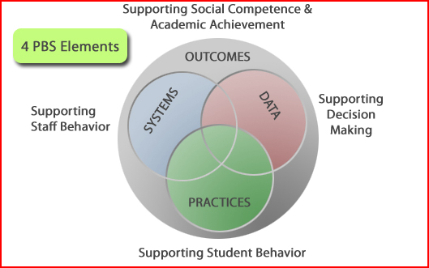
PBIS in our School A School-wide Positive behavior Intervention and Support Proposal
PBIS.org has created a handy visual representation of this.
SWPBIS

Slide 14
PBIS in our School A School-wide Positive behavior Intervention and Support Proposal
Key Principles and Ideas
This must be seen as a Systems Change Process which …
Focuses on teaching behavioral expectations and,
Focuses on preferred behaviors – NOT just telling students what not to do.
In essence, this is a “reculturing” or “renorming” of our school which will hopefully prevent negative behaviors occurring in the first place.
As part of this process, it defines a three tier prevention model of Instructional and Positive behavior Support.
These are Primary, Secondary and Tertiary Preventions that are represented on the next slide.
SWPBIS

Slide 15
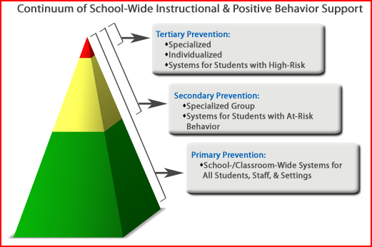
PBIS in our School A School-wide Positive behavior Intervention and Support Proposal
SWPBIS

Slide 16
PBIS in our School A School-wide Positive behavior Intervention and Support Proposal
The OSEP Center on Positive Behavioral Interventions and Supports suggests the following application of the three tiered approach to prevent school bullying:
They suggest that PBIS takes a multi-tiered responsiveness-to-intervention approach to preventing bullying behavior which is derived directly from the “3‐tiered” public health prevention logic.
At Tier I, all students and staff are taught directly and formally about how to behave in safe, respectful, and responsible ways across all school settings. The emphasis is on teaching and encouraging positive social skills and character traits. If implemented well, most students will benefit and be successful.
At Tier II, students whose behaviors do not respond to Tier I supports are provided additional preventive strategies that involve (a) more targeted social skills instruction, (b) increased adult monitoring and positive attention, (c) specific and regular daily feedback on their behavioral progress, and (d) additional academic supports, if necessary.
At Tier III, students whose behaviors do not respond to Tier I and II supports are Provided intensive preventive strategies that involve (a) highly individualized academic and/or behavior intervention planning; (b) more comprehensive, person-centered and function‐based wraparound processes; and (c) school-family-community mental health supports.
SWPBIS

Slide 17
PBIS in our School A School-wide Positive behavior Intervention and Support Proposal
Strategies for implementation of PBIS at our school
Let’s look at and brainstorm ideas for so that we can create a menu of interventions for each tier.
I would suggest 3 groups, each with 15 mins to discuss and report back on what interventions could work for us.
We will divide up alphabetically as follows:
Surnames A-G – Will deal with Tier 1
Surnames H – P – Will deal with Tier 2
Surmanes Q to Z – will deal with Tier 3
….don’t worry, I checked, the groups will be roughly the same size.
SWPBIS

Slide 18
PBIS in our School A School-wide Positive behavior Intervention and Support Proposal
You now have 15 mins to discuss your assigned tier within your group
Be sure to:
Write down some ideas for interventions on the large sheets provided.
Elect a spokesperson to give brief feedback
Stick your sheet on the wall
SWPBIS

Slide 19
PBIS in our School A School-wide Positive behavior Intervention and Support Proposal
SWPBIS
Feedback Time

Slide 20
PBIS in our School A School-wide Positive behavior Intervention and Support Proposal
Lets look at some specific examples that, I’m sure will coincide with what you have thought of.
SWPBIS

Slide 21
PBIS in our School A School-wide Positive behavior Intervention and Support Proposal
Tier 1 (where the most intervention will take place)
Our School wide PBIS needs to be visible all over the school so posters, videos, announcements need to be constantly reinforcing this.
We need to engage in direct teaching of what behaviors are appropriate – always explaining why.
We must help students to learn how to self-reflect with the hope that eventually they will know how to ask for help and a “space” if they feel things are starting to “get out of control”
Inclusivity must be the catch word. Clubs, Sports, hobby and cultural groups. We must ask if every child has a place/niche in the school. Big Brother/Big Sister Days and Friendship days.
We must engage in positive rituals. Those which build a school identity and that build the community. We must go out of our way to issue “I caught you doing something right” slips. These go a long way in providing sufficient reinforcement to sustain positive behavior.
We must place a focus on leadership training and character development of all students. We must always have high expectations in this area.
We must encourage students to give as much (if not more) than they get. They must be community and outward minded
SWPBIS

Slide 22
PBIS in our School A School-wide Positive behavior Intervention and Support Proposal
Tier 2 (for the few that need additional supports)
We will need to establish Anger Management Groups in conjunction with the school psychologist. And various other need specific groups such as :
Social Skills training Groups
Bereavement Groups
Academic skills and remediation groups which will have explored ways of implementing computer assisted instruction, student tutors such as the tutor-tutee program established by our NHS, etc.
Specific leadership training and problem solving skills may need to be taught to individuals
Persistent behavior problems may have to check-in and check-out every day with their homeroom teacher and possibly carry a Daily Report that has to be signed by each of their period teachers.
Remember the self-reflection training mentioned in Tier 1.
SWPBIS

Slide 23
PBIS in our School A School-wide Positive behavior Intervention and Support Proposal
Tier 3 (when all else fails)
We will need to establish a Functional Assessment and behavior Intervention Planning team.
The FA and BIP team would have to have a clear set of guidelines (guided by school and, if needs be, state policy) for referrals.
The schools discipline policy would also have to be adjusted to work in conjunction with the recommendations of the FA and BIP team.
One–on-One behavioral Intervention – for this we would have to be proactive and embark on a professional development program that engages the help of specialists (psychologists, psychiatrists, social workers etc.)
We would need to establish a dedicated behavioral/ learning area which will give students a “cool-down”, “vent frustration” place to be at first which should eventually develop into a “problem solving” area to which students could come if they needed to “let off steam or if they needed longer term help. This would hopefully be as a result of the Self-Reflection training mentioned in Tier 1&2.
SWPBIS

Slide 24
PBIS in our School A School-wide Positive behavior Intervention and Support Proposal
In order to apply these strategies, we need to develop school wide matrices that help us to start dealing with, for example in our context, the issue of bullying.
What follows is one of many suggested matrices that we could use to attempt to counter the effects of bullying. It focuses on the positive behavioral aspect of “Respect for Others”.
SWPBIS

Slide 25
PBIS in our School A School-wide Positive behavior Intervention and Support Proposal
 | Classroom | Playground | Restroom | Residences
 | Raise hand when you want to speak | Remember safety comes first | Keep the area as neat as you found it or even neater. | Treat other’s property with respect
 | Remember to listen to other’s point of view | Try to give everyone a chance with the ball | Wait your turn | Remember that others may be studying when you are enjoying free time
 | Prefer others | Try to help those who are battling | Wash your hands and help others to remember as well | Help to create a caring community
SWPBIS
Respect for others

Slide 26
PBIS in our School A School-wide Positive behavior Intervention and Support Proposal
Here are some strategies for the implementation at the school-wide and Classroom level of this or other matrices:
Direct teaching – in the classroom, residences, assemblies and in extra curricular activities. We should aim to integrate specific elements of our PBIS matrix into our lessons. We will also develop and/or source relevant lesson plans.
Informal teaching – modeling, referring to the disciplinary elements while teaching, target and look for desired behaviors and reward them.
Visual reinforcement – bulletin boards, posters, on the school intra- and internet, assembly skits, etc.
Positive reinforcement – seeking and acknowledging examples of desired characteristics, make available and encourage the issuing of “caught you doing something right” notes by both staff and students, special awards?
A new matrix will be chosen to be the focus of each week
SWPBIS

Slide 27
PBIS in our School A School-wide Positive behavior Intervention and Support Proposal
We have so many areas of the school for …
Assignments
Assemblies
Journal
Residence Chats at Check-in
Discussion
Staff Meetings
SWPBIS
Practical Apps.
Conversations
Chapel
Classroom Integration
Discussion
Age-Appropriate
Check-in
Rewards
Devotions
PBIS
Implementation
& Integration
School
Dorm
Discipline
Residence Integration
Bulletin Boards
Employees
Rewards
Admin./Support
Coaching
Sports/ Extra-murals
Student Leaders
Skills
Residence Council
Publications
Parent Letters
NHS/Other
Sportsmanship
Fans
Student Council
School Intranet
General Publications
Website

Slide 28
PBIS in our School A School-wide Positive behavior Intervention and Support Proposal
Community-Wide Integration should involve:
The School (Day)
The Residences
Faculty
Administration & Support Staff
Parents
The broader community
it’s “All or nothing!”
SWPBIS

Slide 29
PBIS in our School A School-wide Positive behavior Intervention and Support Proposal
So where to from here – The following needs to be considered:
Program Phases | Key Activities
Proposal | Present program; set-up committees
Information Gathering | School-wide input on Appropriate behaviors
Education | Staff training; online resources
Implementation | Launch at beginning of new academic year
Data Collection | Ongoing
Evaluation | Short & long term
SWPBIS

Slide 30
PBIS in our School A School-wide Positive behavior Intervention and Support Proposal
Lets look at …
SWPBIS
Evaluation | Short & long term

Slide 31
PBIS in our School A School-wide Positive behavior Intervention and Support Proposal
Evaluation Ideas – What Data do we collect to know whether PBIS is working in our school.
We need to:
Create benchmarks
Create or use existing Functional Assessment Checklists of Teachers
Create or use existing Classroom Checklists for Individual Student Systems
Create or use existing Classroom Management Self-Assessments
Develop ways of analysing and evaluating the data. Data based decision making will be crucial in reinforcing this plan.
SWPBIS

Slide 32
PBIS in our School A School-wide Positive behavior Intervention and Support Proposal
SWPBIS
An example of how data can help us to make decisions

Slide 33
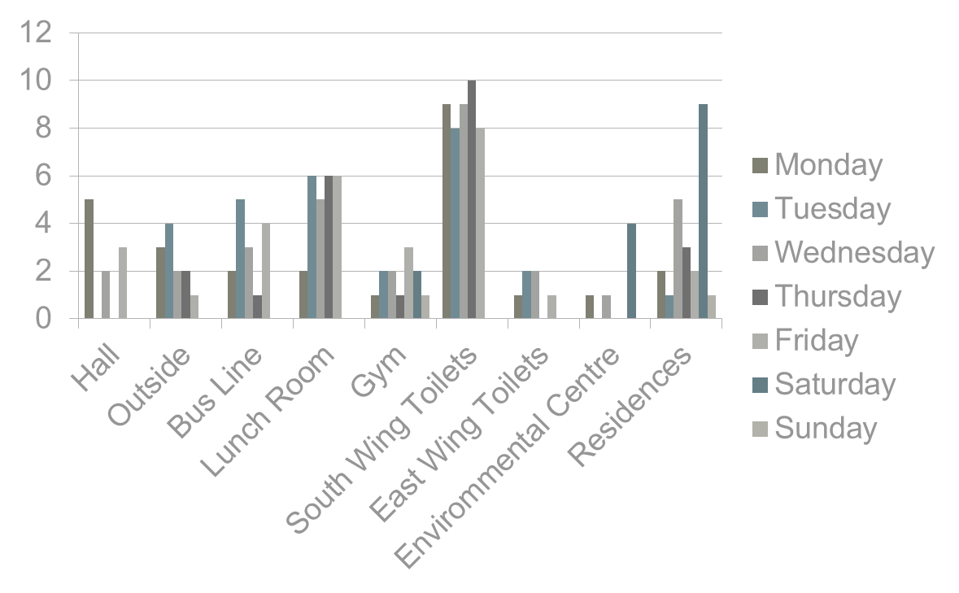
Number of incidences reported at various places around the school on the different days of the week
SWPBIS

Slide 34
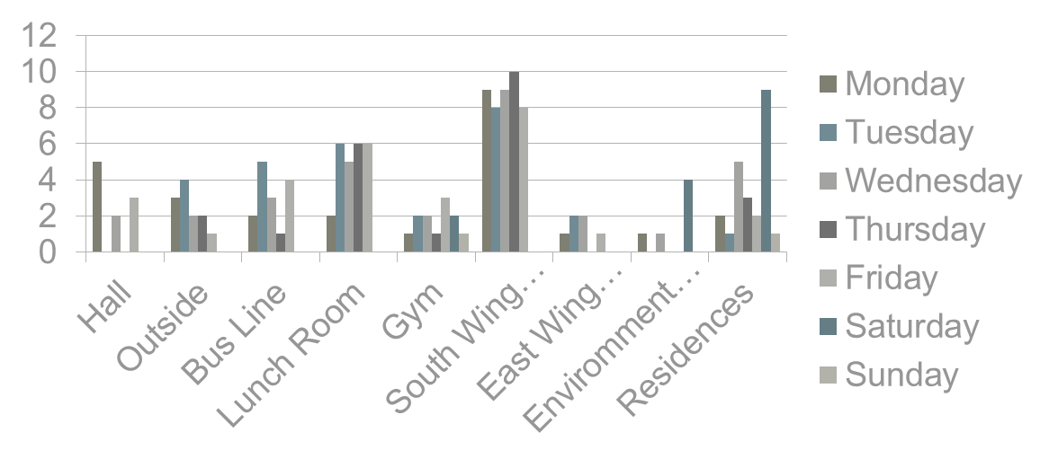
PBIS in our School A School-wide Positive behavior Intervention and Support Proposal
We can deduce a few issues here:
Some of the obvious ones are:
The South Wing Toilets clearly need more monitoring
The lunch room may need a rethink regarding monitoring
The environmental centre needs some help over the weekend
Anything else …. ?
SWPBIS

Slide 35
PBIS in our School A School-wide Positive behavior Intervention and Support Proposal
Other areas for data collection:
Specific Behavioral types – eg. Insubordination, verbal aggression, physical aggression, task refusal, tardiness etc.
More locations could be identified
From whom or from where is the referral or reporting coming.
When during the day is the specific behavior happening.
How is this affecting academics
And possibly most important of all …. Are we reinforcing and recording positive behaviour
SWPBIS

Slide 36
PBIS in our School A School-wide Positive behavior Intervention and Support Proposal
… Are we reinforcing and recording positive behaviour?
Are we using the “I caught you doing something right” slips?
SWPBIS

Slide 37
PBIS in our School A School-wide Positive behavior Intervention and Support Proposal
Roadblocks to Success
Curriculum Pressure
“Tyranny of the clock”
Stress
Fatigue
Over-commitment
Lack of readily available resources
Inadequate Professional Development
SWPBIS

Slide 38
PBIS in our School A School-wide Positive behavior Intervention and Support Proposal
"The time is always right to do what is right.”
Martin Luther King Jr.
SWPBIS

Slide 39
Sources:
http://www.cecp.air.org/
http://www.pbis.org/common/pbisresources/publications/PBSMonographComplete.pdf
http://www.pbis.org/common/pbisresources/publications/PBIS_Bullying_Behavior_Apr19_2011.pdf
Course Lecture notes
SWPBIS

Slide 40
NEXT MEETING
4
August
2011

